Slide 1


ABC Bank Customer Churn Info 583 Data mining for Business Analytics
Group 8
Dr. Stanislav Mamonov
Dr. Xinrong Lei
Group 8
SHUBHANSHI PANDEY
MARIANA TAPIEROS ARIAS

Slide 2


Business Case
Objective
Our objective is to design a model to anticipate the possibility if a customer may churn and their characteristics.
Introduction
Churn in the banking industry refers to the situation where customers stop doing business with one bank and go to another. It can be costly to acquire new customers, negatively impact the bank's ability to forecast financial performance, and make it more difficult to attract new customers. It can also damage the bank's reputation and make it more difficult to attract new customers.

Slide 3


Data Set
Data source: Kaggle
https://www.kaggle.com/datasets/gauravtopre/bank-customer-churn-dataset
Size:
10.000 records.
12 Attributes.
Target Variable: “Churn”
Yes = 1
No = 0
Attributes
customer_id, unused variable. Is a unique number.
credit_score, used as input. Creditworthiness of a customer.
country, used as input. France, Germany, and Spain.
gender, used as input. Female or Male.
age, used as input.
tenure, used as input. Years as a customer.
balance, used as input.
products_number, used as input.
credit_card, used as input. Yes = 1 , No = 0.
active_member, used as input. Yes = 1 , No = 0.
estimated_salary, used as input.
churn, used as the target. Yes = 1 , No = 0.

Slide 4

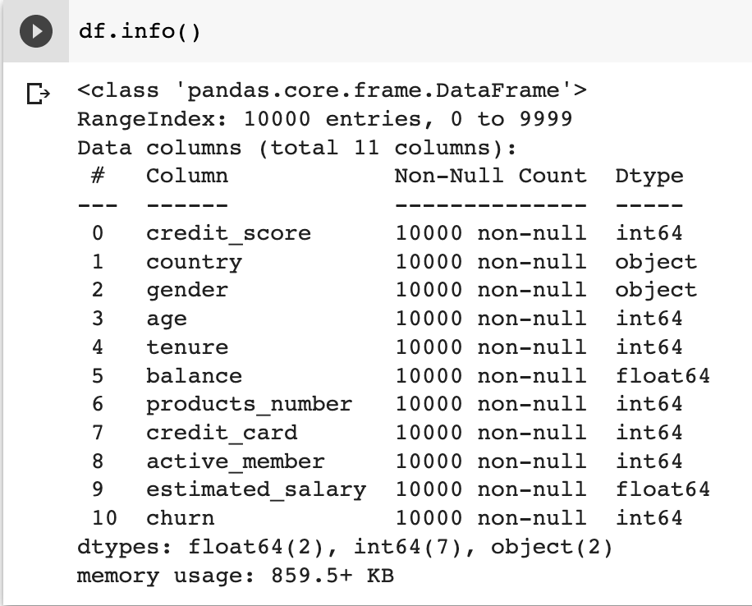
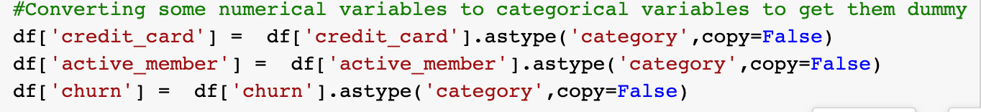
Data Pre-processing
1. Data Type
2. Dropping undesirable variables
3. Converting variables to categorical variables to dummy code them

Slide 5
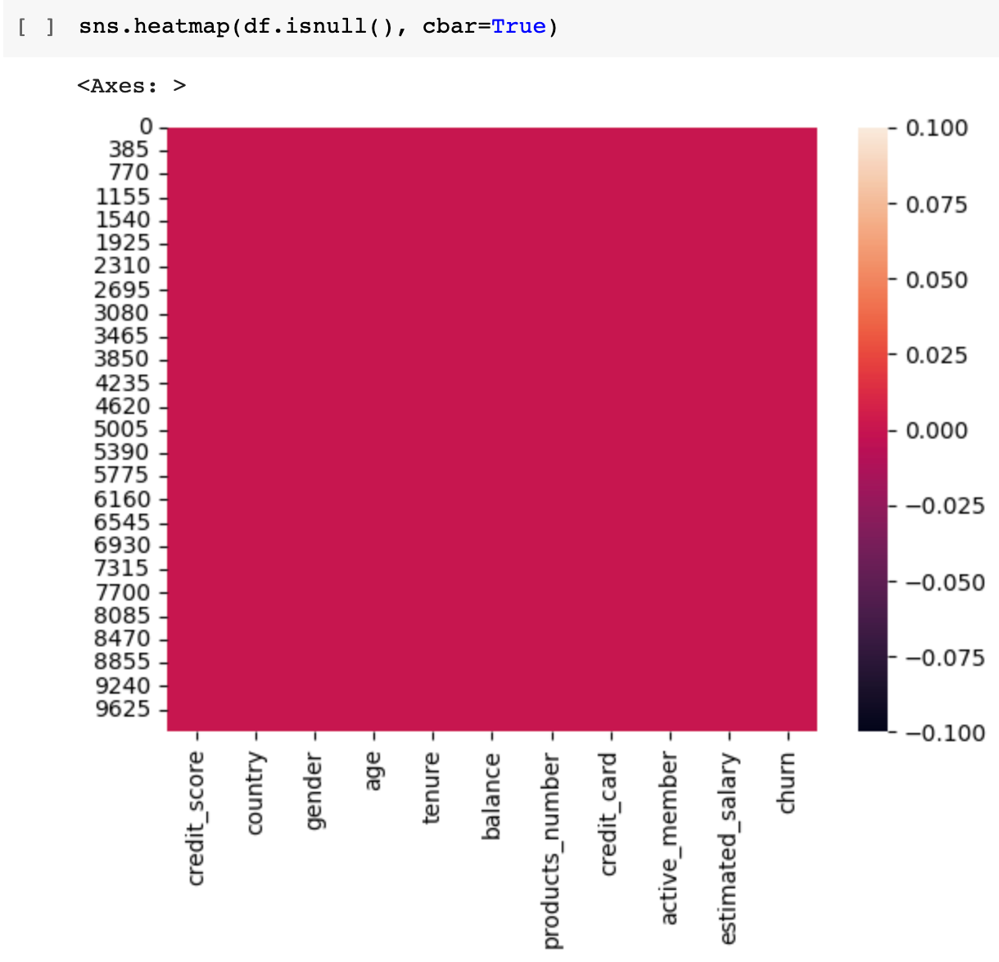
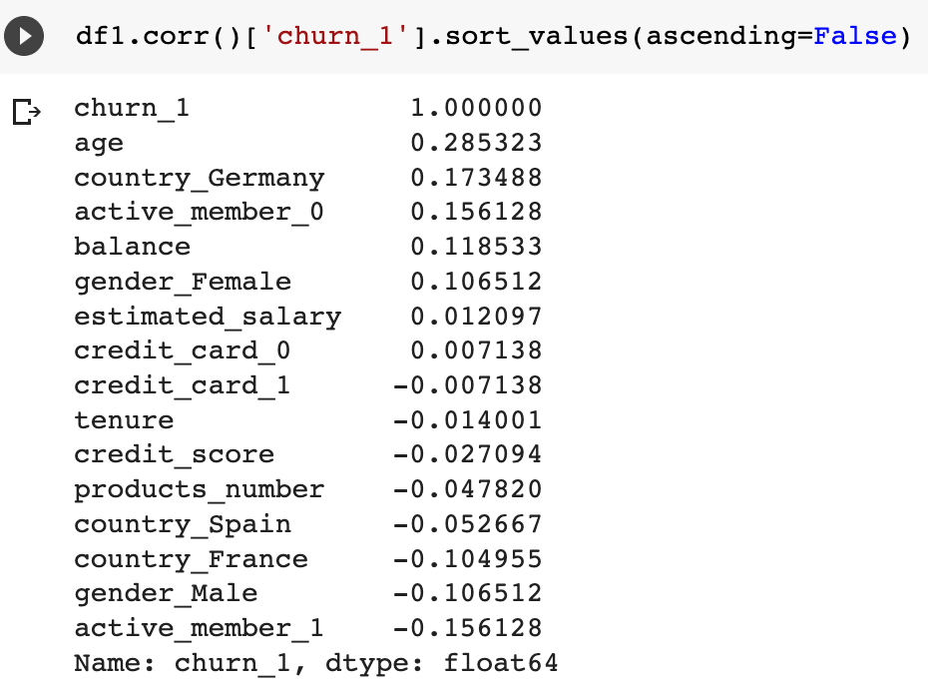
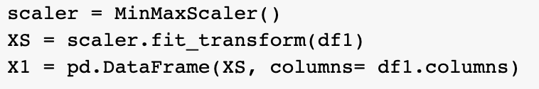
Data Pre-processing
4. Identify missing values
5. Identify correlation with target variable
6. Scale the data for modeling purpose

Slide 6
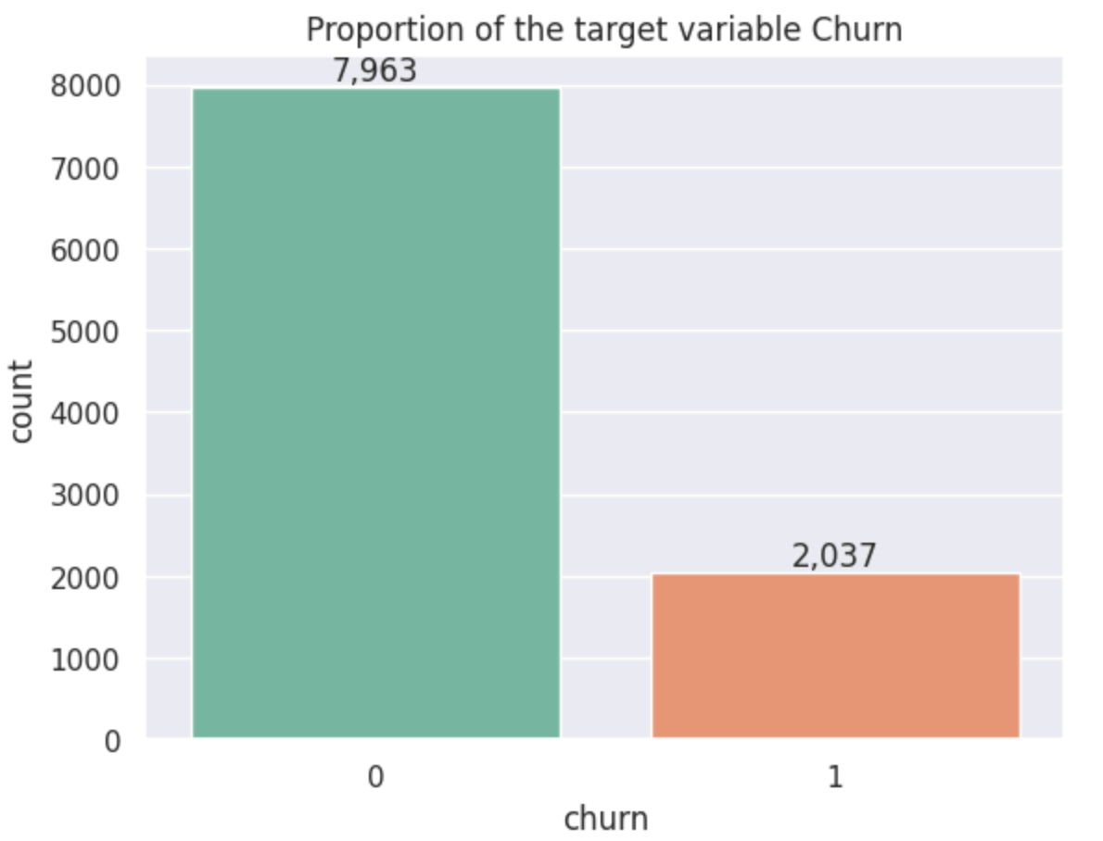
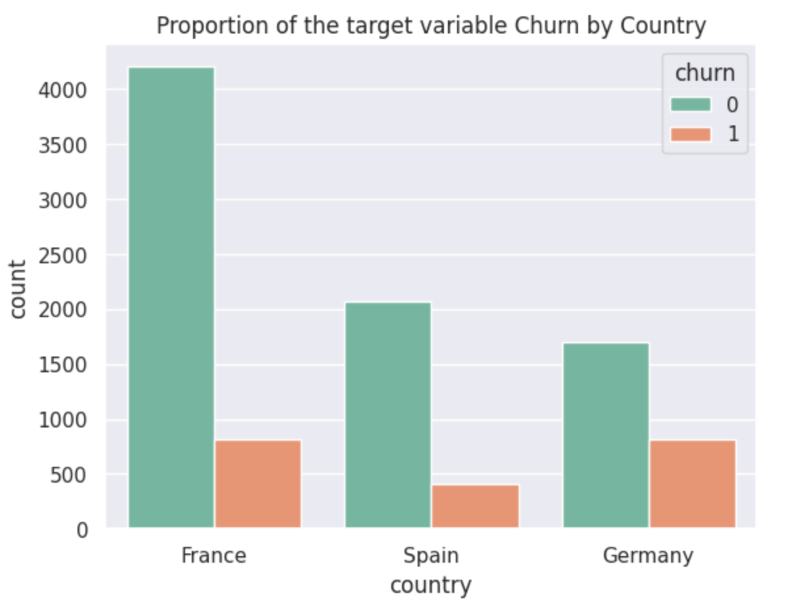
Data Visualization and Insights
4,204
83.84%
79.63%
2,064
1,695
83.32%
814
67.55%
810
20.37%
16.15%
413
16.68%
32.44%

Slide 7
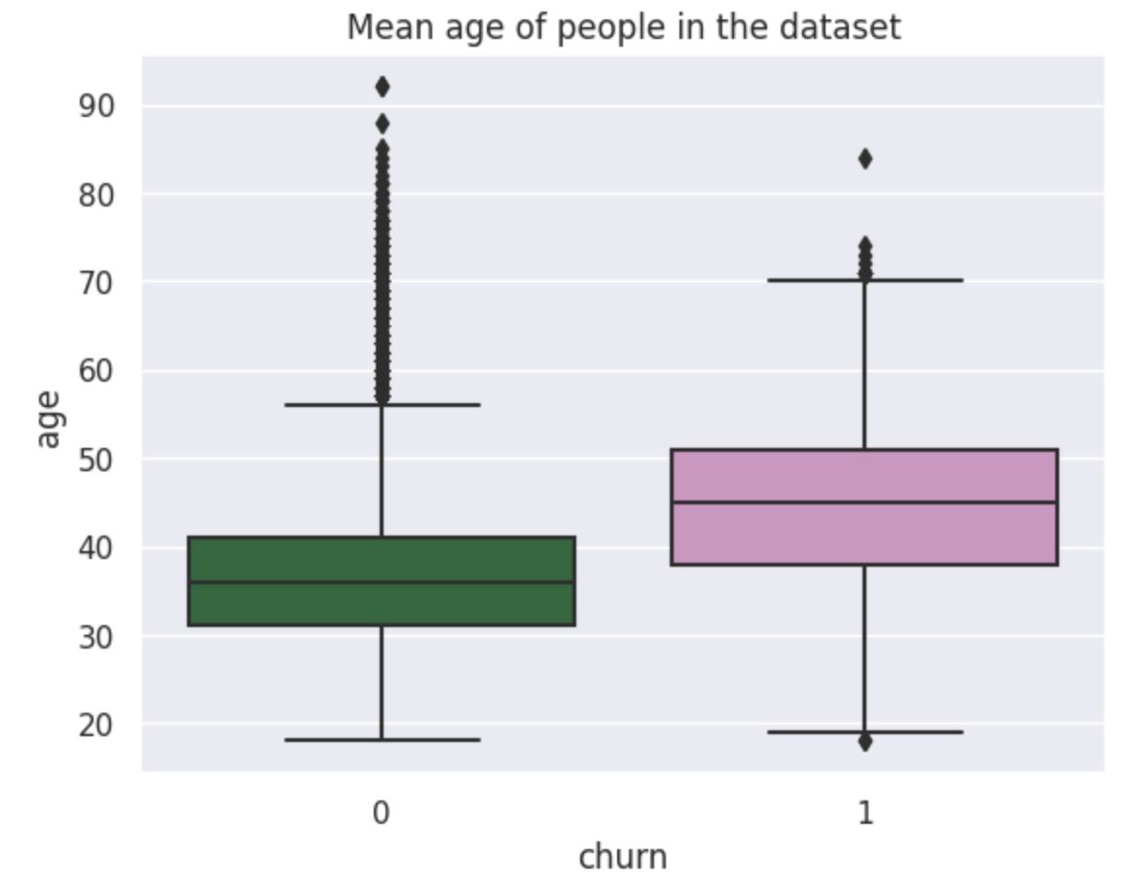
Data Visualization and Insights

Slide 8
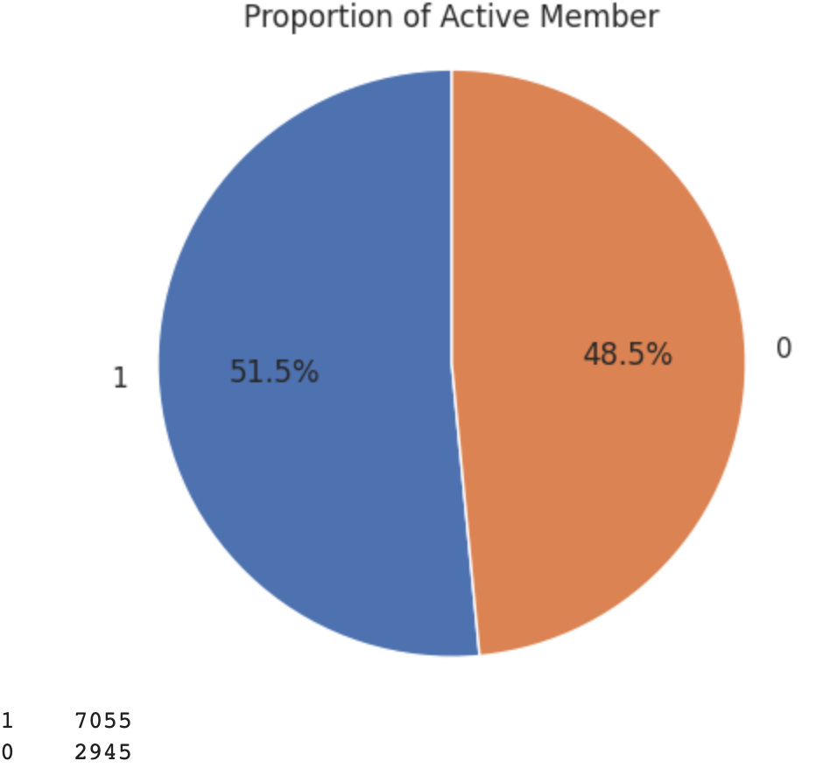
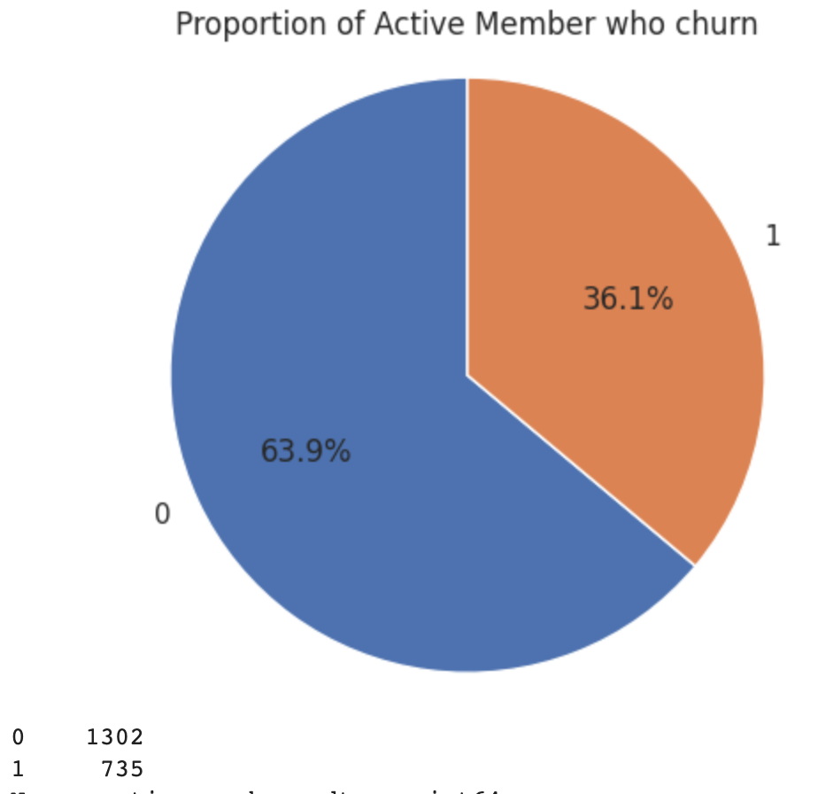
Data Visualization and Insights

Slide 9
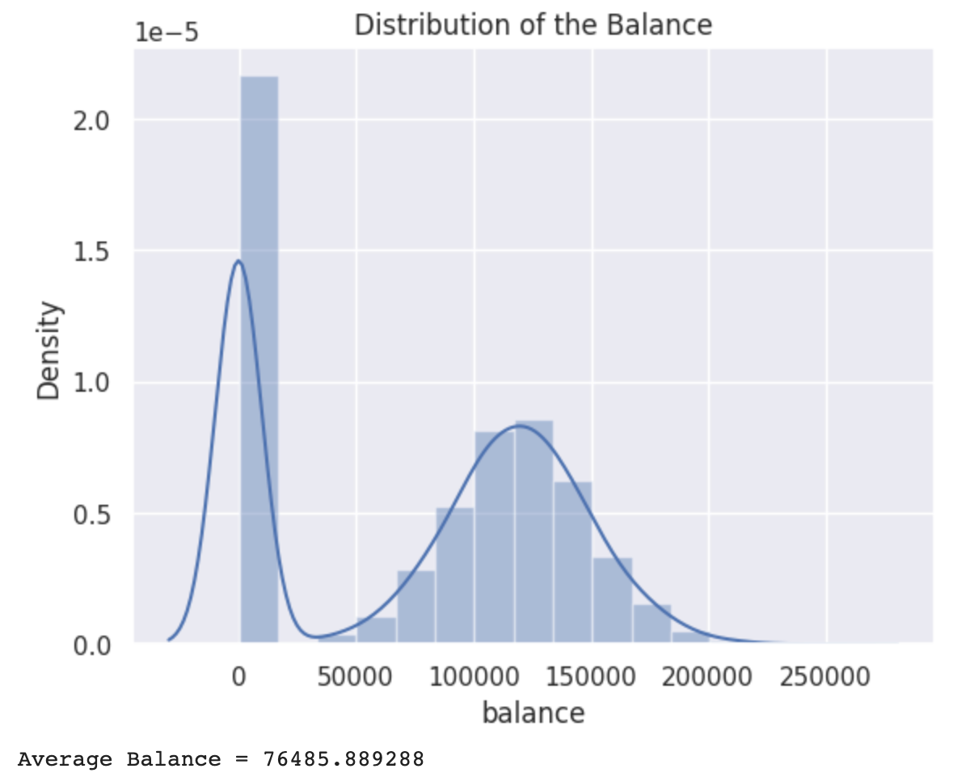
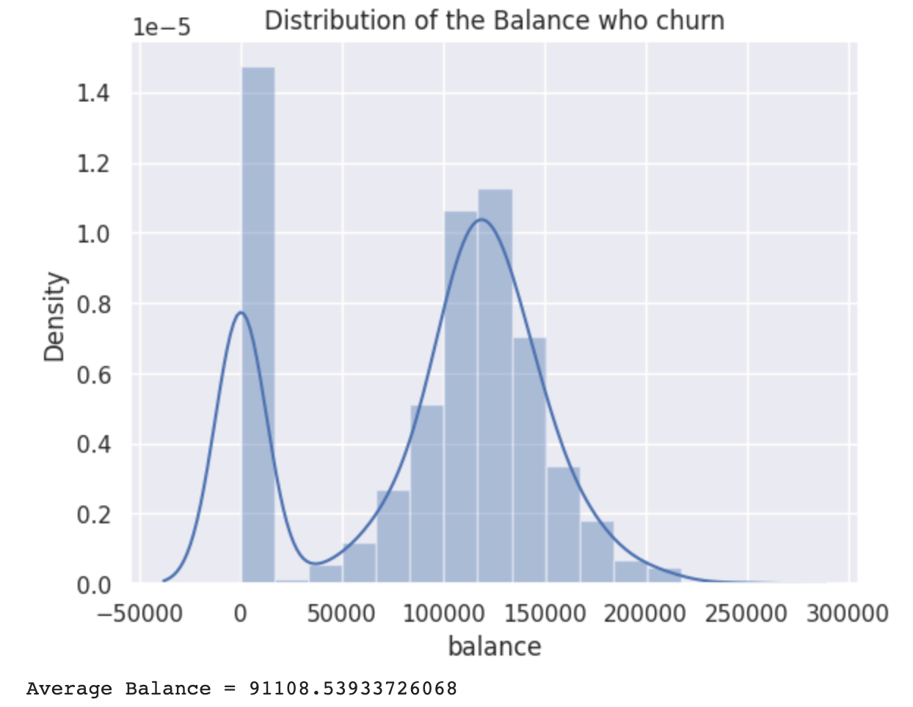
Data Visualization and Insights

Slide 10
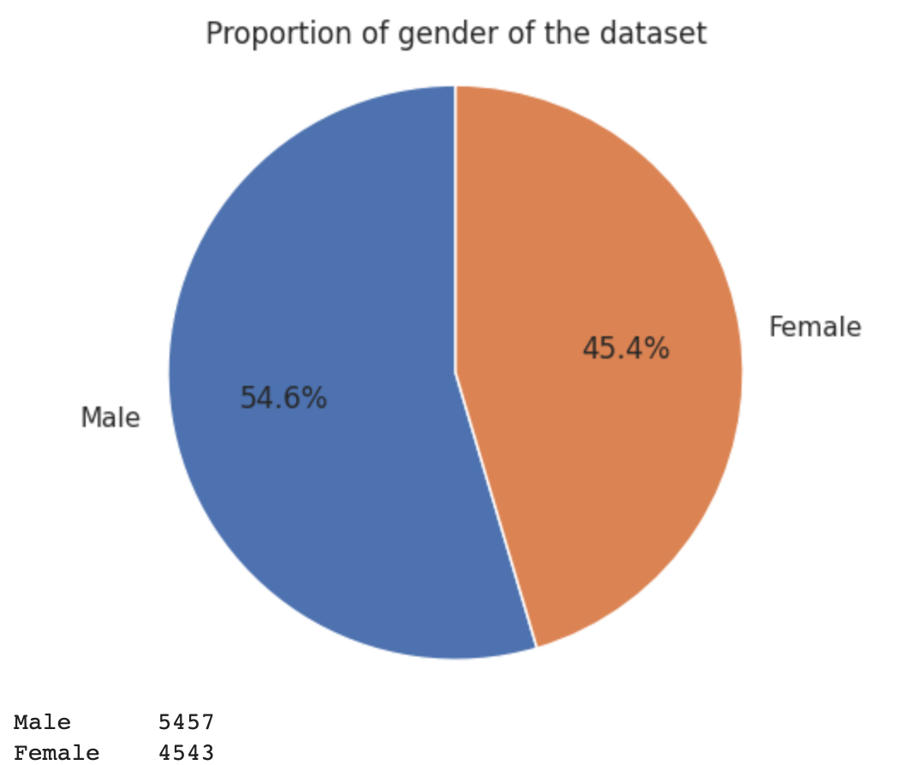
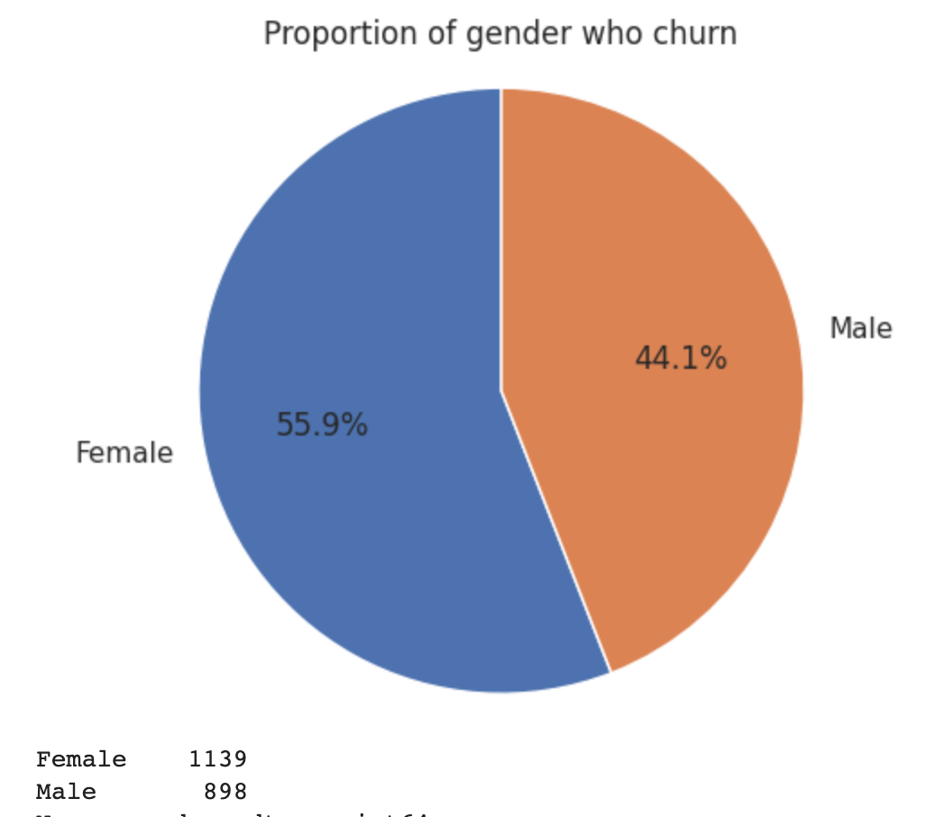
Data Visualization and Insights

Slide 11
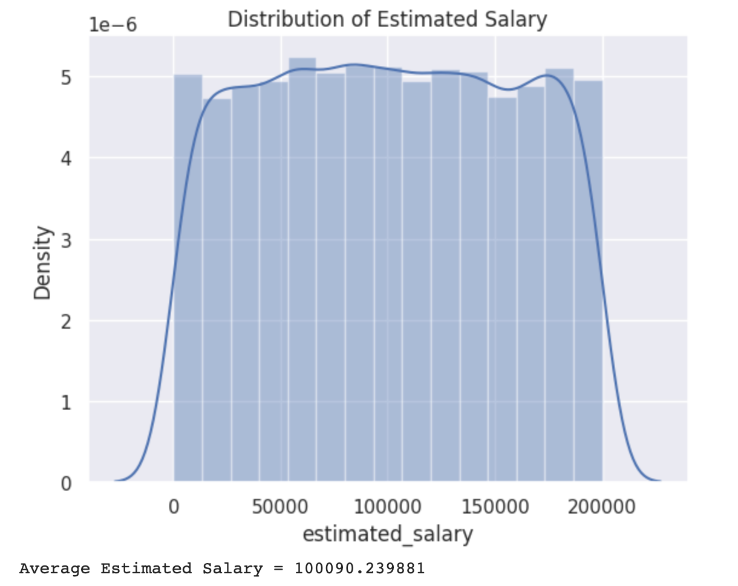
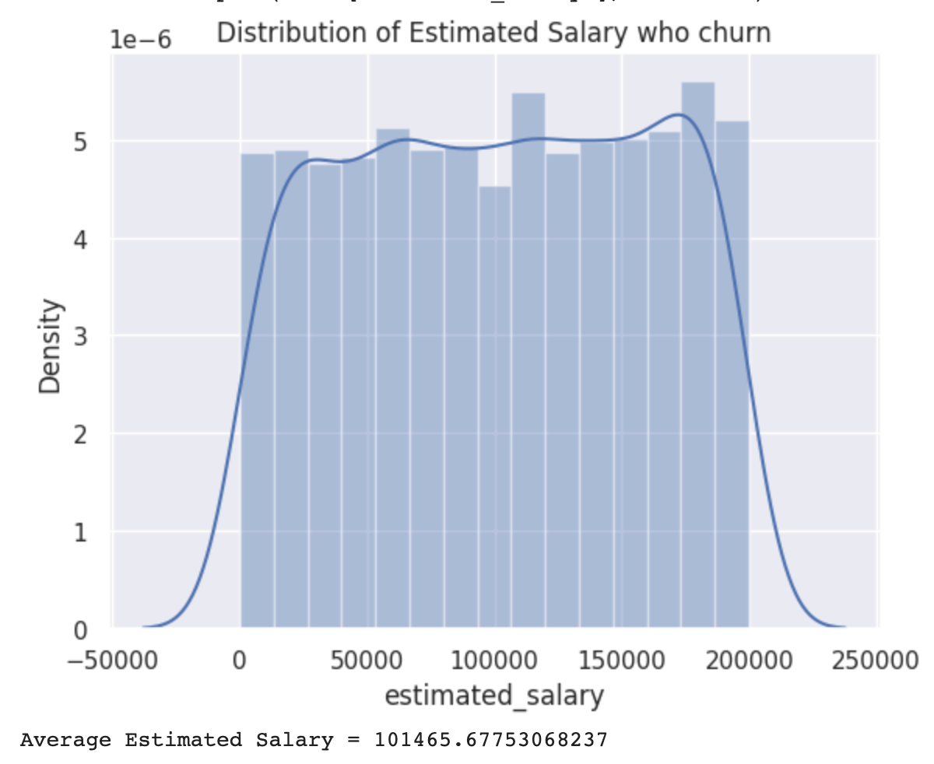
Data Visualization and Insights

Slide 12
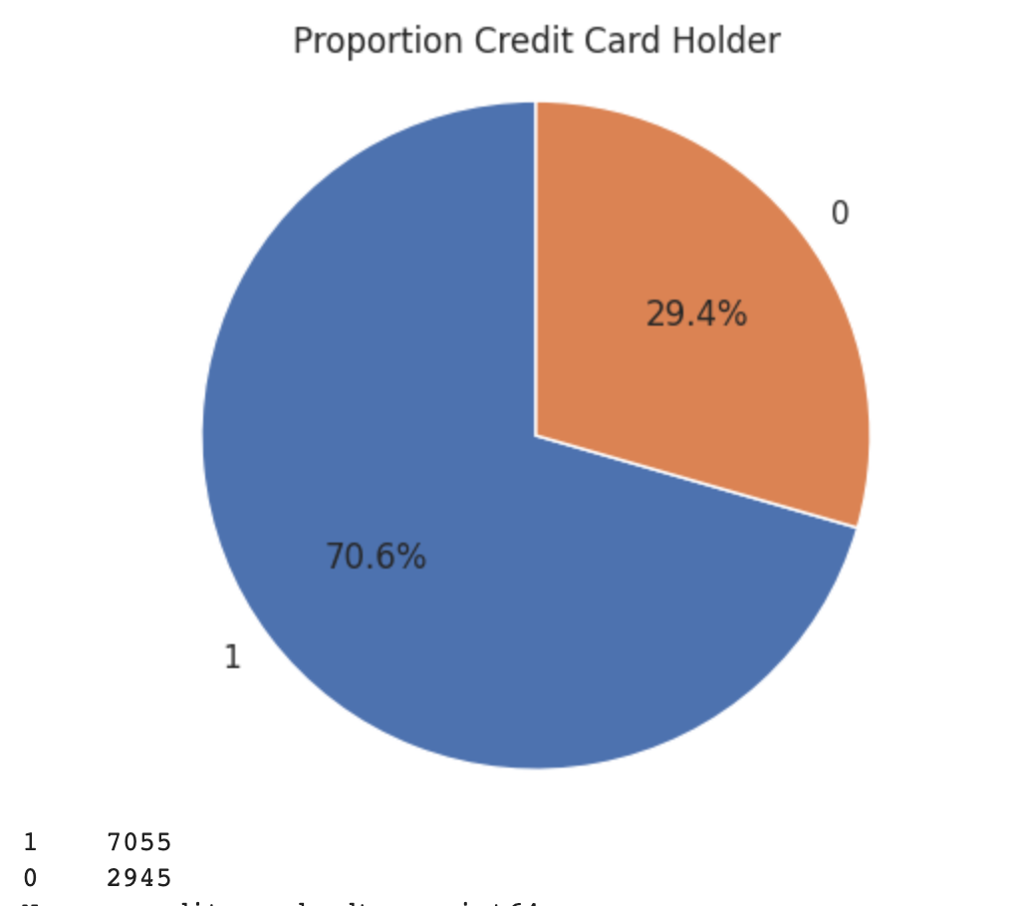
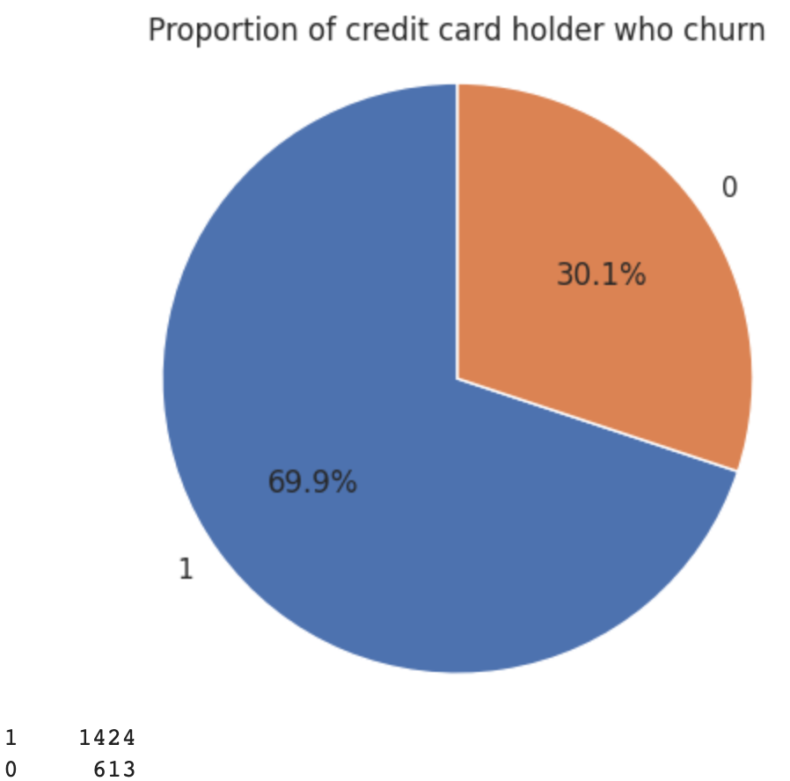
Data Visualization and Insights

Slide 13
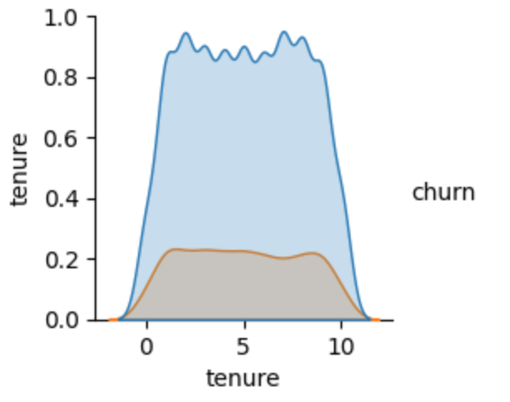
Data Visualization and Insights
Distribution of tenure people who churn

Slide 14
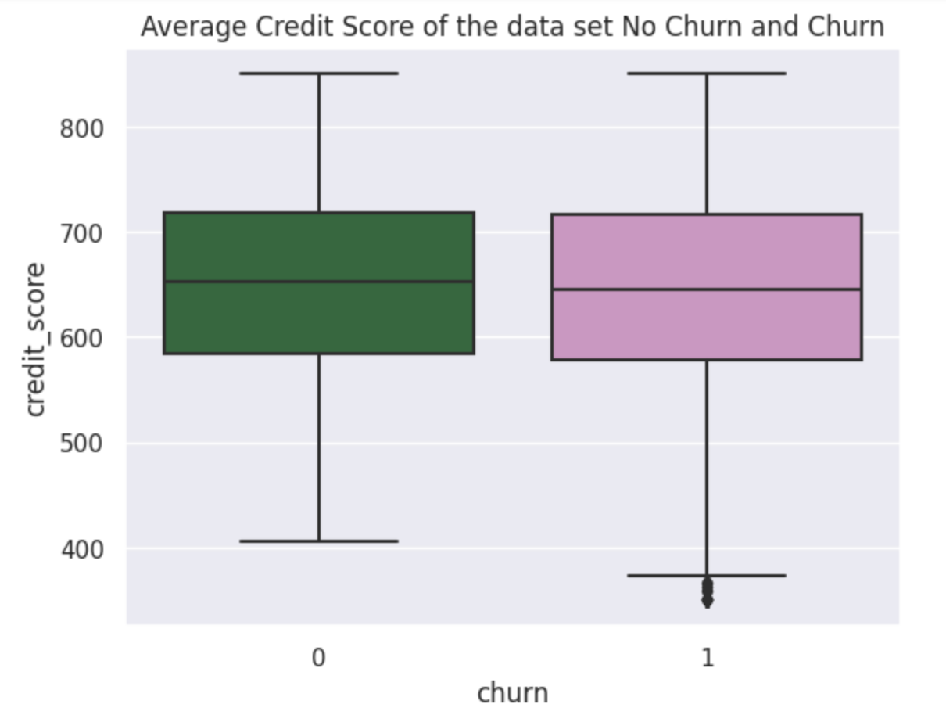
Data Visualization and Insights

Slide 15
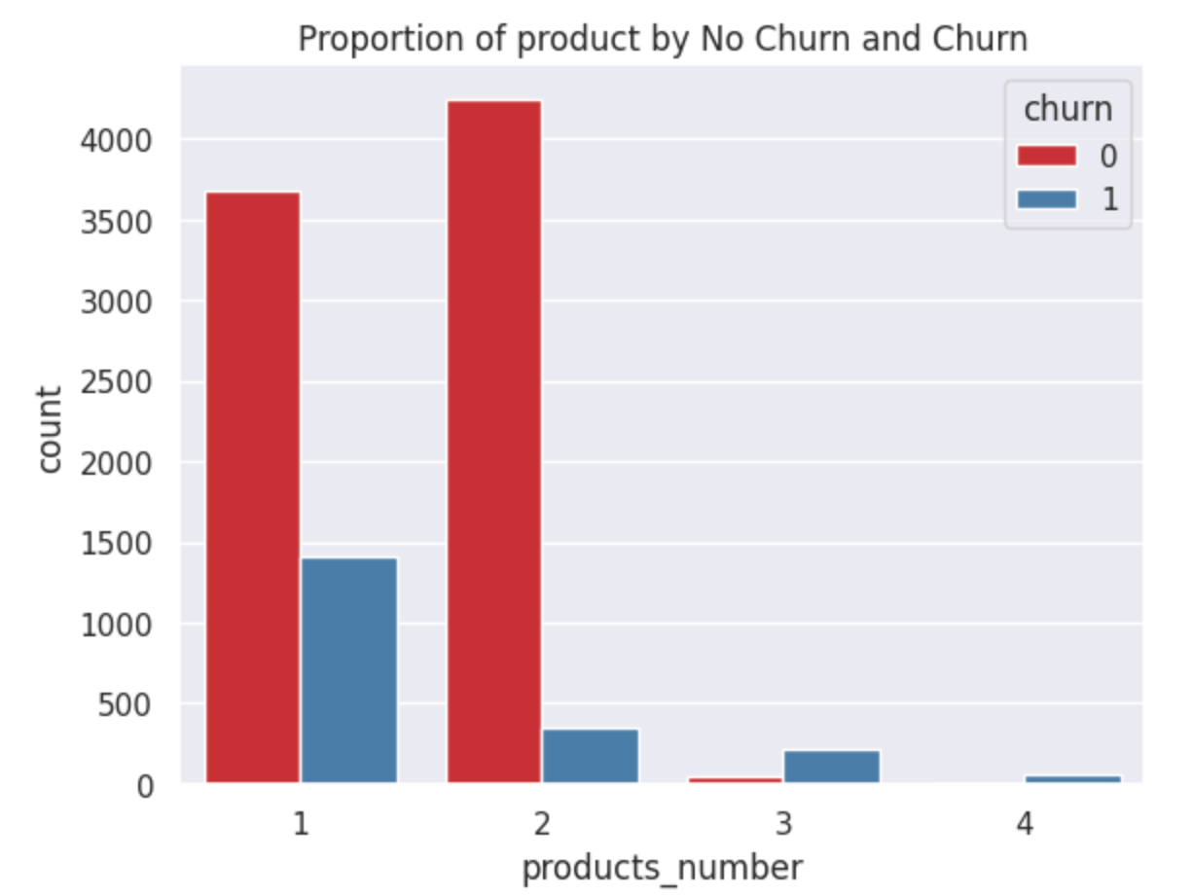
Data Visualization and Insights

Slide 16
Models Perform
Model |  | ROC_AUC Prob | Accuracy | F1 | Recall or True Positive | Precision or Positive Predicted Value
Logistic Regression | 0 | 0.77 | 0.81 | 0.89 | 0.97 | 0.82
 | 1 |  |  | 0.31 | 0.21 | 0.67
kNN | 0 | 0.75 | 0.8 | 0.89 | 0.97 | 0.82
 | 1 |  |  | 0.27 | 0.17 | 0.6
Random Forest | 0 | 0.84 | 0.84 | 0.91 | 0.99 | 0.84
 | 1 |  |  | 0.45 | 0.3 | 0.86
Boosted Tree | 0 | 0.84 | 0.85 | 0.91 | 0.96 | 0.87
 | 1 |  |  | 0.57 | 0.46 | 0.75
Naive Bayes | 0 | 0.54 | 0.54 | 0.66 | 0.55 | 0.82
 | 1 |  |  | 0.33 | 0.53 | 0.24
ANN | 0 | 0.78 | 0.81 | 0.89 | 0.98 | 0.82
 | 1 |  |  | 0.32 | 0.21 | 0.69
Keras | 0 | 0.54 * Predict Prob | 0.54 | 0.66 | 0.55 | 0.82
 | 1 |  |  | 0.33 | 0.53 | 0.24

Slide 17
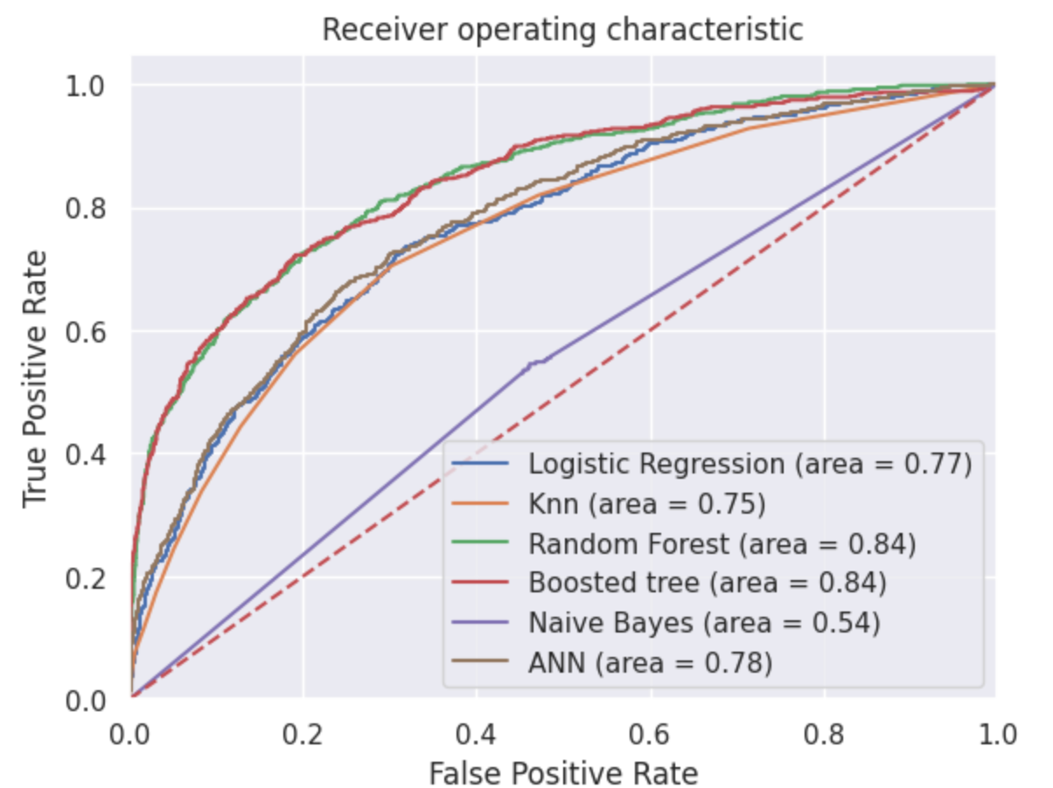
ROC Curve

Slide 18




Conclusion and Recommendations
We can conclude that Boosted tree model had a good perform for the data set and can help us to identify which customer may churn over time.
Bank may reward clients with large account balances or provide tailored suggestions to each customer based on their past transactions.
By leveraging the insights generated, banks can develop targeted retention strategies to reduce customer churn, like offering incentives to the customers with a transaction history.
Banks should target in creating a strong one-to-one relationship with their customers through good communication to increase their loyalty
Inactive Member
Over 45 YO
$9.110

